Slide 1
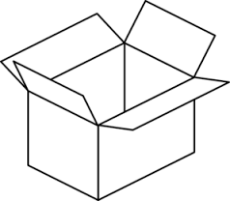
Web Design MCOSS2WED
Flexbox

Slide 2
Why flexbox?
It can be difficult to control element layout whilst keeping content flexible enough to cope with a wide variety of viewports.

Slide 3
Why flexbox?
Very easy to align elements vertically and horizontally.
Easy to distribute space evenly.
Element order can be reversed.
Elements can be told to wrap within a container.
A column of elements can easily be produced.

Slide 4
Why flexbox?
The CSS3 Flexible Box, or flexbox, is a layout mode providing for the arrangement of elements on a page such that the elements behave predictably when the page layout must accommodate different screen sizes and different display devices.
Taken from https://developer.mozilla.org/...Flexible_Box.../Using_CSS_flexible_boxes.
Accessed 24/10/2016.

Slide 5
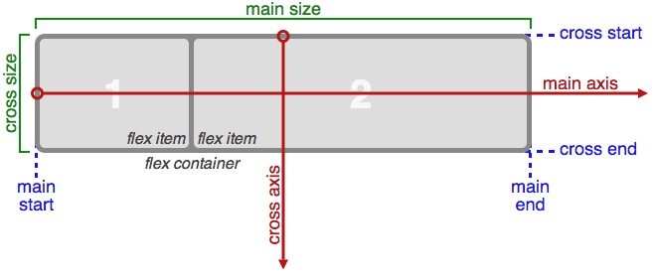
Basics
Taken from https://www.w3.org/TR/css-flexbox-1/
Accessed 24/10/2016

Slide 6
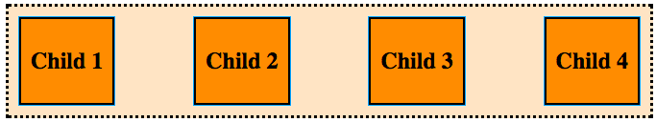
Basics
Flexboxes are containers with a style display type of flex or inline-flex.
Layout options are specified within the parent flexbox container – not the child elements.
See flex-example1.html & .css (display: flex;)

Slide 7
Justification
Elements within a flexbox can be justified horizontally in multiple ways using justify-content:
Centre
Flex-start
Flex-end
Space-around
Space-between
Demo justification using flex-example1.css

Slide 8
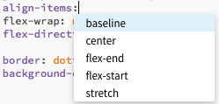
Alignment
Elements can be aligned vertically in similar ways using align-items.

Slide 9
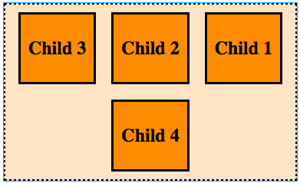
Order
Wrap (flex-wrap) and direction (flex-direction) can be specified.
Demo wrap and direction using flex-example1.css

Slide 10

Codepen.io demonstration
Check out https://codepen.io/LandonSchropp/pen/KpzzGo/ for a good demo of flexbox layout

Slide 11
Design brief
Display, distribute and read through the Image Comics Design Brief:
Available to download from:
http://www.iteachit.net/docs/flex-brief.pdf

